Slide 1
PRADEEPA P 821721243039 B.E-Computer Science of Engineering – IIIyear Sir Issac Newton College Of Engineering And Technology
3/21/2024 Annual Review

Slide 2
PROJECT TITLE
Heart Failure Prevention
(using ANN)

Slide 3


AGENDA
The agenda of Heart failure Prevention using Artificial Neural
Networks (ANNs).This project includes several key tasks:
Evaluate the model
Train the model
Compile the model
Compile the model
Build the ANN model
Data preprocessing
Import necessary libraries
This task has several broader objectives and potential applications
3/21/2024 Annual Review

Slide 4

PROBLEM STATEMENT
Develop an Artificial Neural Network (ANN) in Python to predict the likelihood of heart failure based on relevant patient data such as age, gender, medical history, and lifestyle factors.
Utilize a dataset containing features like blood pressure, cholesterol levels, and exercise habits.
Train the ANN model to accurately classify patients as either at risk or not at risk of heart failure.
Optimize the ANN architecture and parameters to improve prediction accuracy and generalization performance.
3/21/2024 Annual Review

Slide 5

PROJECT OVERVIEW
Project Title: Heart Failure Prevention using ANN
Objective: Develop an Artificial Neural Network (ANN) model in Python to predict the likelihood of heart failure based on patient data.
Dataset: Utilize a dataset containing various patient attributes such as age, blood pressure, cholesterol levels, etc.
Preprocessing: Cleanse and preprocess the data, including handling missing values and scaling numerical features.
Model Development: Construct and train the ANN model using libraries like TensorFlow or Keras, optimizing for accuracy and performance.
Evaluation: Assess the model’s performance through metrics such as accuracy, precision, recall, and F1-score, and iterate on improvements if necessary.
3/21/2024 Annual Review

Slide 6

WHO ARE THE END USERS?
1. Import necessary libraries like TensorFlow and Keras. 2. Prepare and preprocess heart failure data. 3. Design and build an Artificial Neural Network model using Python. 4. Train the model on the prepared data. 5. Evaluate the model’s performance on validation data. 6. Deploy the trained model for end users to predict heart failure risk and preventions using Python-based applications or interfaces.
3/21/2024 Annual Review

Slide 7

YOUR SOLUTION AND ITS VALUE PROPOSITION
My solution employs an ANN to analyze patient data, identifying risk factors for heart failure. It predicts the likelihood of heart failure occurrence, enabling early intervention. Leveraging Python’s libraries like TensorFlow, it offers scalability and efficiency, contributing to proactive healthcare management.
3/21/2024 Annual Review

Slide 8

THE WOW IN YOUR SOLUTION
“The WOW in Your Solution” for heart failure prevention using ANN in Python: 1. Implement a multi-layer perceptron (MLP) neural network architecture. 2. Utilize TensorFlow or PyTorch libraries for efficient computation. 3. Preprocess data, including feature scaling and splitting into training and testing sets. 4. Train the ANN model using backpropagation and gradient descent algorithms. 5. Optimize hyperparameters such as learning rate and number of hidden layers. 6. Evaluate the model’s performance using metrics like accuracy, precision, and recall to ensure effectiveness in heart failure prediction.
3/21/2024 Annual Review
8

Slide 9
MODELLING
To model heart failure prevention using Artificial Neural Networks (ANN) in Python: 1. Import necessary libraries such as TensorFlow or PyTorch for ANN implementation. 2. Prepare the dataset, including features related to heart health and outcomes. 3. Design the architecture of the ANN, specifying the number of layers and neurons. 4. Train the ANN using the prepared dataset, adjusting parameters to optimize performance. 5. Validate the model using separate data to assess its effectiveness in predicting heart failure. 6. Utilize the trained ANN for heart failure prevention by making predictions based on new data..
3/21/2024 Annual Review
9

Slide 10
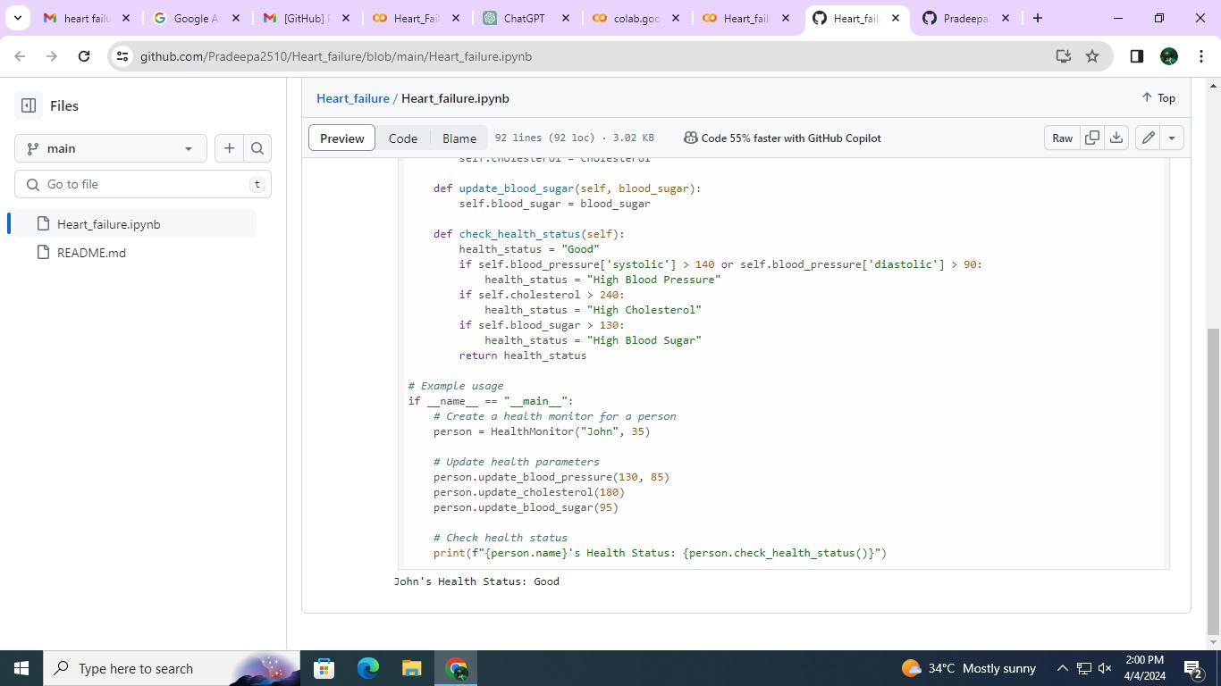
RESULTS
Demo Link
3/21/2024 Annual Review
10

